Slide 1
MINOR PROJECT - 1
TOPIC : STUDENT ATTENDANCE SYSTEM USING QR SCAN

Slide 2
PROJECT SUPERVISOR
Dr. Nileshkumar R. Patel
Faculty Member (CSE)
Notes:
Notes to presenter:
What is your purpose for sharing this reflection?
Is it at the end of a unit or project?
Are you sharing this reflection, at the attainment of a learning goal you set for yourself?
Is it at the end of a course?
State your purpose for the reflection or even the purpose of the learning experience or learning goal. Be clear and be specific in stating your purpose.

Slide 3

Presented by:
Ashutosh Srivastava 201B072
Pakhi Vashishth 201B171
Pampa Ghosh 201B173
Notes:
Notes to presenter:
Description of what you learned in your own words on one side.
Include information about the topic
Details about the topic will also be helpful here.
Tell the story of your learning experience. Just like a story there should always be a beginning, middle and an end.
On the other side, you can add a graphic that provides evidence of what you learned.
Feel free to use more than one slide to reflect upon your process. It also helps to add some video of your process.

Slide 4
CONTENT
1. OBJECTIVE
2. SYSTEM BASED ON
3. NEED OF PROJECT
4. STRUCTURE
5. WORKING
6. BLOCK DIAGRAM
7. TOOLS AND TECHNOLOGIES
8. EXPECTED OUTCOME
9. ADVANTAGES
10. SYSTEM REQUIREMENTS
11. REFERENCES

Slide 5
OBJECTIVE
The objective of this project is to ease the attendance marking system for both professors and students. The developed system will use QR codes to mark the attendance of students, which will reduce the attendance-taking time and will allow the professor to deliver more useful content in their lectures.

Slide 6


SYSTEM BASED ON
ANDROID APP
WEB PORTAL

Slide 7
NEED OF PROJECT?
In bigger lecture theaters like LT-5 or classes with 100+ students, marking attendance is a very time-consuming.
With this project, the attendance time will be reduced to 30sec- 2min, from 10-15mins.

Slide 8
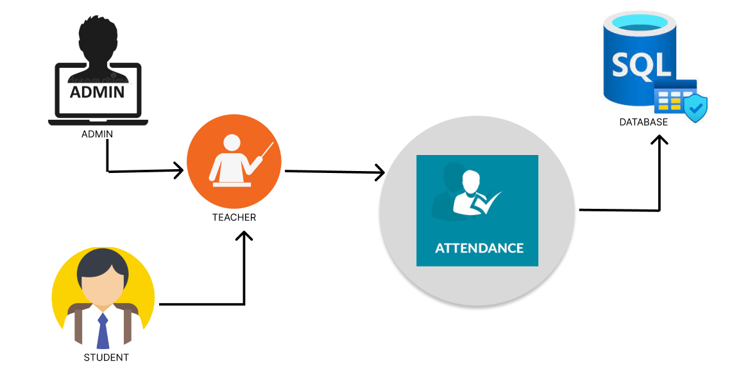
STRUCTURE
Admin Portal
Teacher’s Portal
Student’s Portal

Slide 9

ADMIN PORTAL
Admin portal is web based and will require login.
Admin can add departments, courses, and related information.
In admin portal, only the admin can add professors and assign courses to them.
Admin portal will approve the students registration and also update their information.
Admin will assign courses to the students.

Slide 10

TEACHER’S PORTAL
In this portal, there will be a login for professor.
This is also a web portal.
Professor can generate QR codes for their subjects here.
The data of attendance will be stored here.

Slide 11

STUDENT’S PORTAL
This will be a mobile application.
Students will login after registration on app.
Students will scan QR code with this app.
This app will feature geofencing, and mark present only for students within the marked location.

Slide 12
WORKING
●The professor will generate the QR code on the website. While generating the QR, professors need to enter some data like timing of class, batches and lecture theater number.
● When the QR code is scanned on app, the app will check for all this data and if any data is not present or location is not as per marked area, the attendance won’t be marked.
● If the app found all data to be true, then it will send the student’s data to the website.

Slide 13
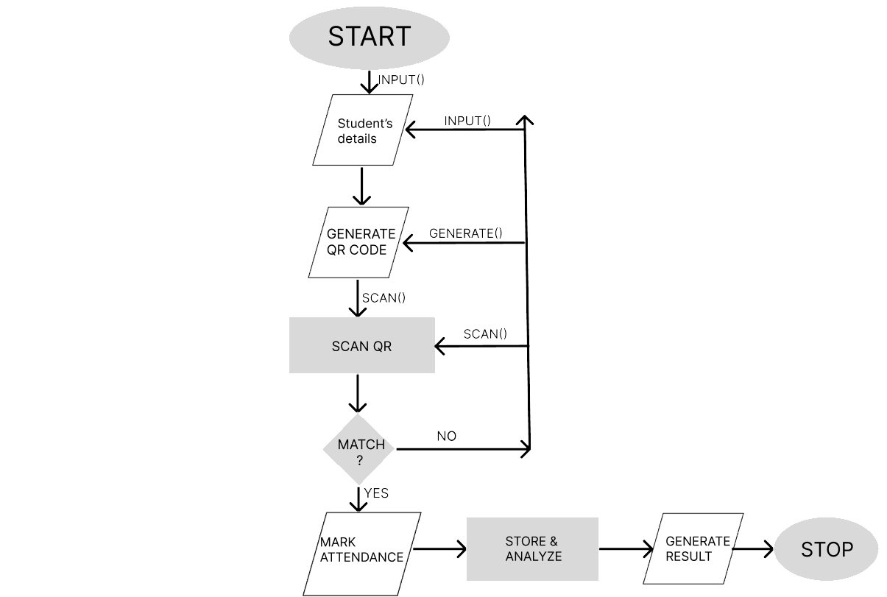
BLOCK DIAGRAM

Slide 14



TOOLS AND TECHNOLOGIES USED
Flutter - Dart
HTML, CSS , JAVASCRIPT
PHP/MYSQL
Node js, Express

Slide 15

EXPECTED OUTCOMES AFTER END SEM
Complete frontend of Mobile app
4
Complete frontend of Web portal
3
2
QR Scanner in mobile app
1
QR generation in website
Notes:
Notes to presenter:
What steps will you be taking as a result of this learning experience?
Did you learn from any failed experiences? How will you do things differently?
What advice will you give to others so they can learn from your experiences?
How can you share what you learned with a real-world audience?
Some examples of next steps might be:
After delivering my first persuasive presentation, I am thinking about joining the debate team.
After making my first film, I’m considering entering it in our school film festival or local film festival.
After connecting with this career expert, I’d like to do some research on that career field because it sounds interesting to me.
This SmartArt allows you add images and text to help outline your process. If a picture is worth a thousand words, then pictures and words should help you communicate this reflection on learning perfectly! You can always click on Insert>SmartArt to change this graphic or select the graphic and click on the Design contextual menu to change the colors.
Feel free to use more than one slide to share your next steps. It also helps to add some video content to explain your message.

Slide 16
MOBILE MODULE (STUDENT’S PORTAL)
Once the QR image has been created, students can use their smartphones and the system's Mobile Module to scan the QR code to verify their attendance by sending the information they have collected to the Server Module.
This Mobile Module is part of Student’s application on their Mobile Phone.
If it is the first time for the student to login into the application, the system requests the student to enter their details like name and enrolment number.
Once logged in, student can’t logout from the app. If they want to re-login, they need to re-install the application.

Slide 17
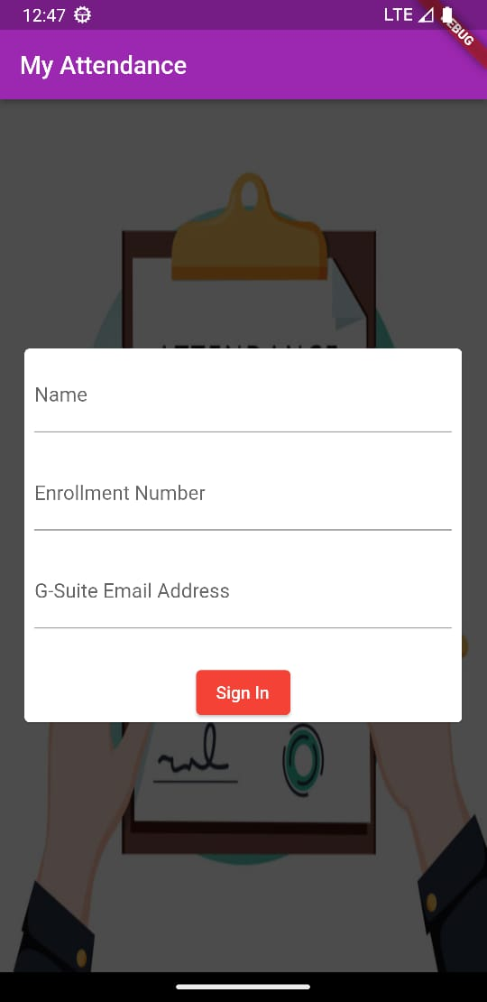
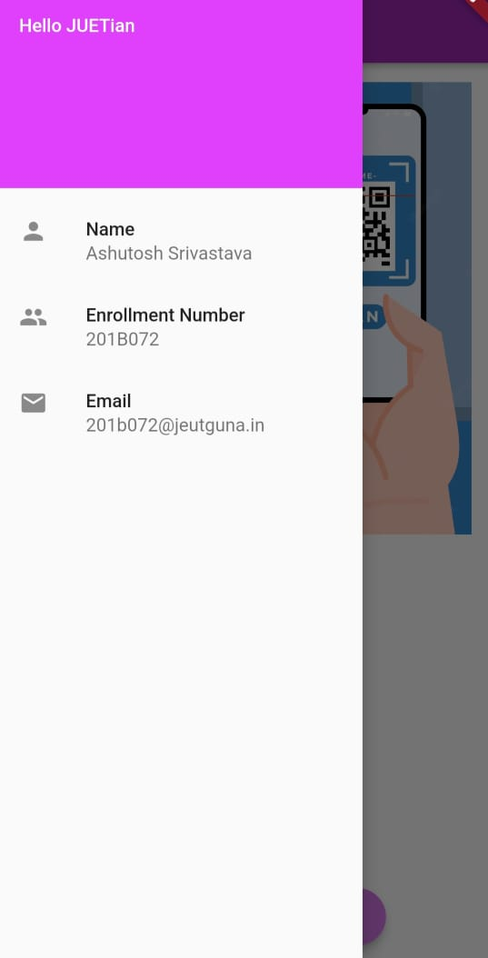
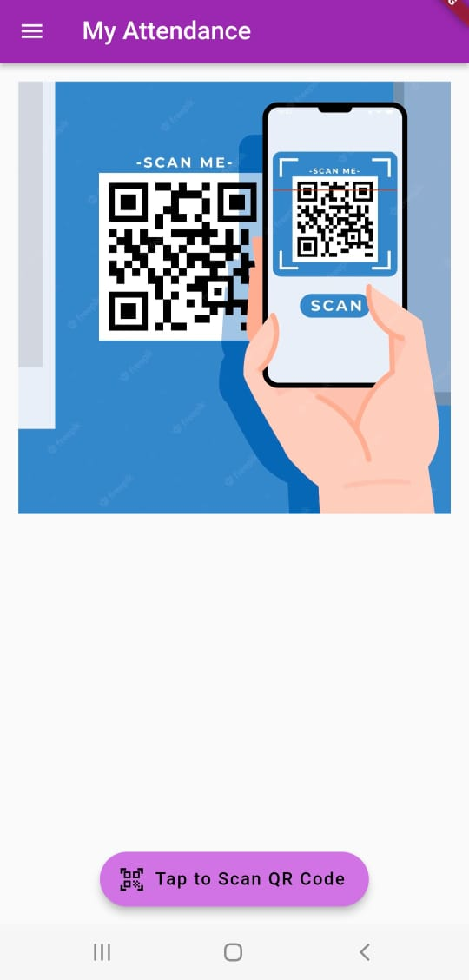
SCREENSHOTS

Slide 18
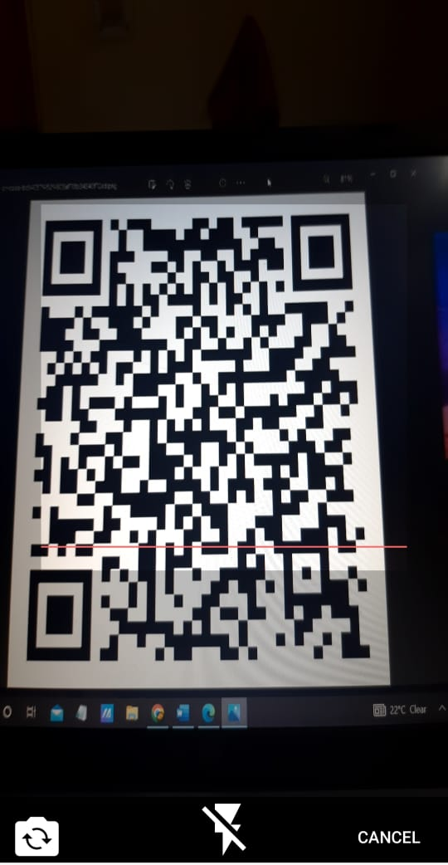
QR SCANNING FROM APP
This QR scanning option in App allow student’s to scan QR that is been displayed on Screen by Teacher.

Slide 19
SERVER MODULE(TEACHER’S PORTAL)
To generate an encrypted QR code with precise information, the system requires a quick login by the class instructor using its Server Module.
Any time before the class is appropriate for doing this. The instructor shows the pupils an encrypted QR code either in the middle of the lesson or at the start.
The system Mobile Module, which is accessible to the students via their smartphones, can then be used to scan the presented QR code.
To verify attendance, the Mobile Module will then transmit the data it has gathered to the Server Module.

Slide 20
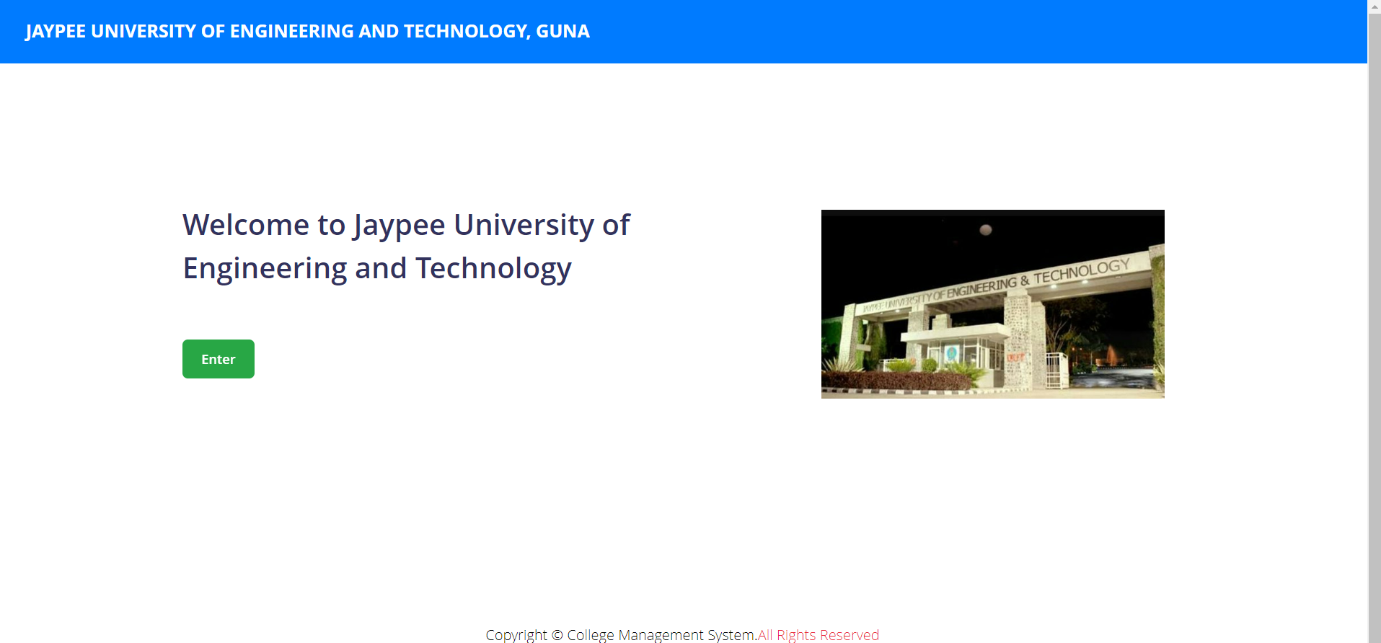
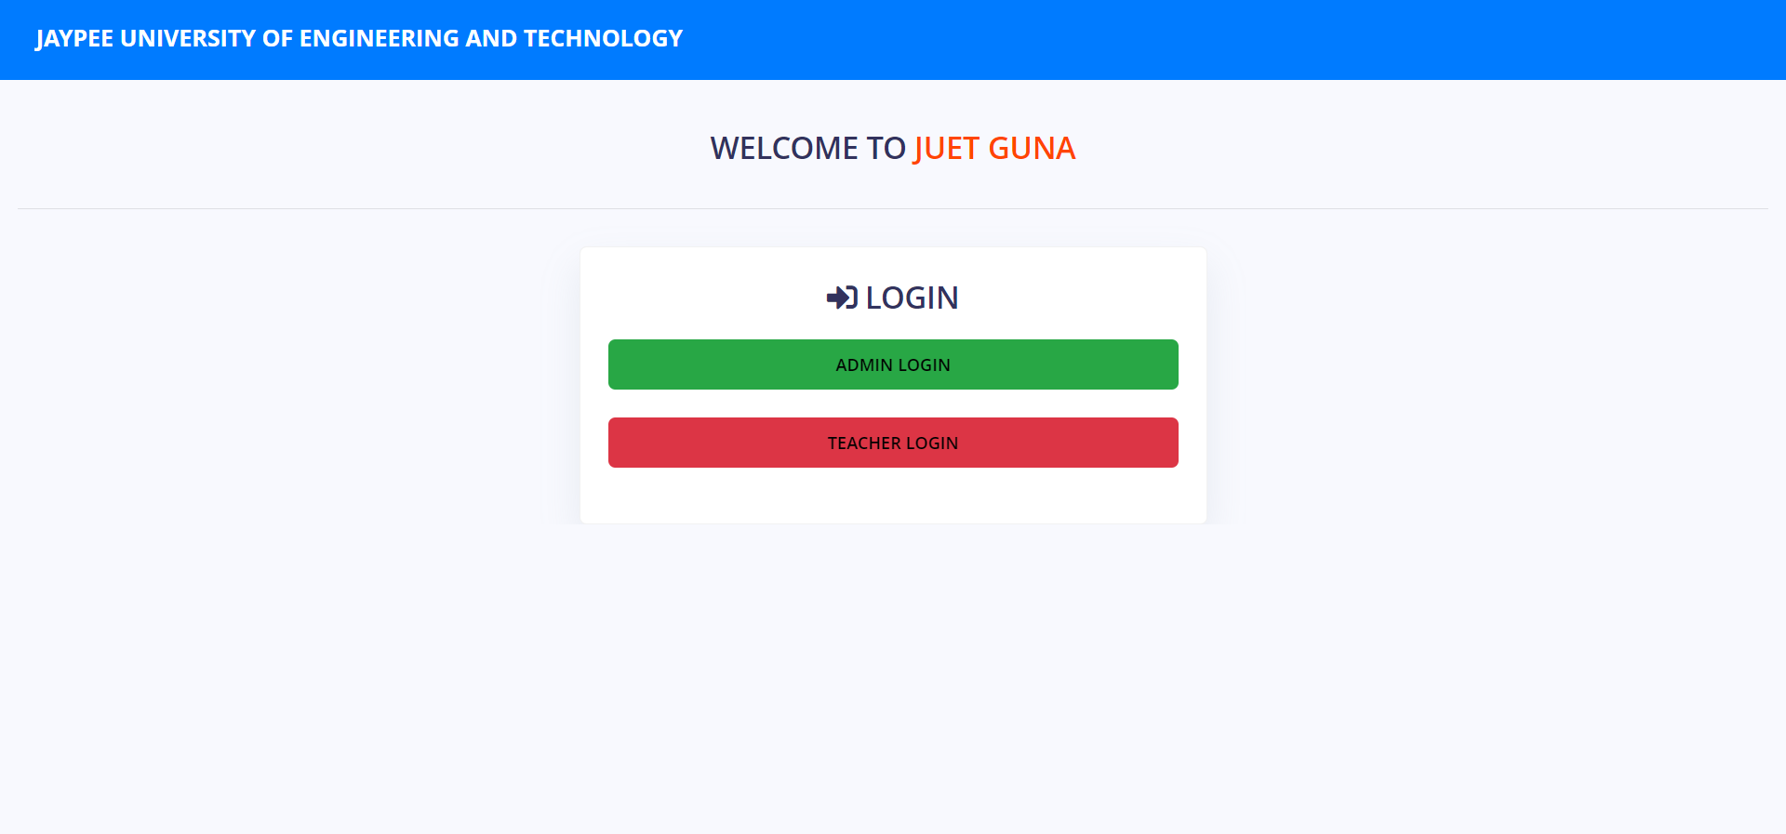
SCREENSHOTS
MAIN PAGE OF WEB PORTAL LOGIN PAGE

Slide 21
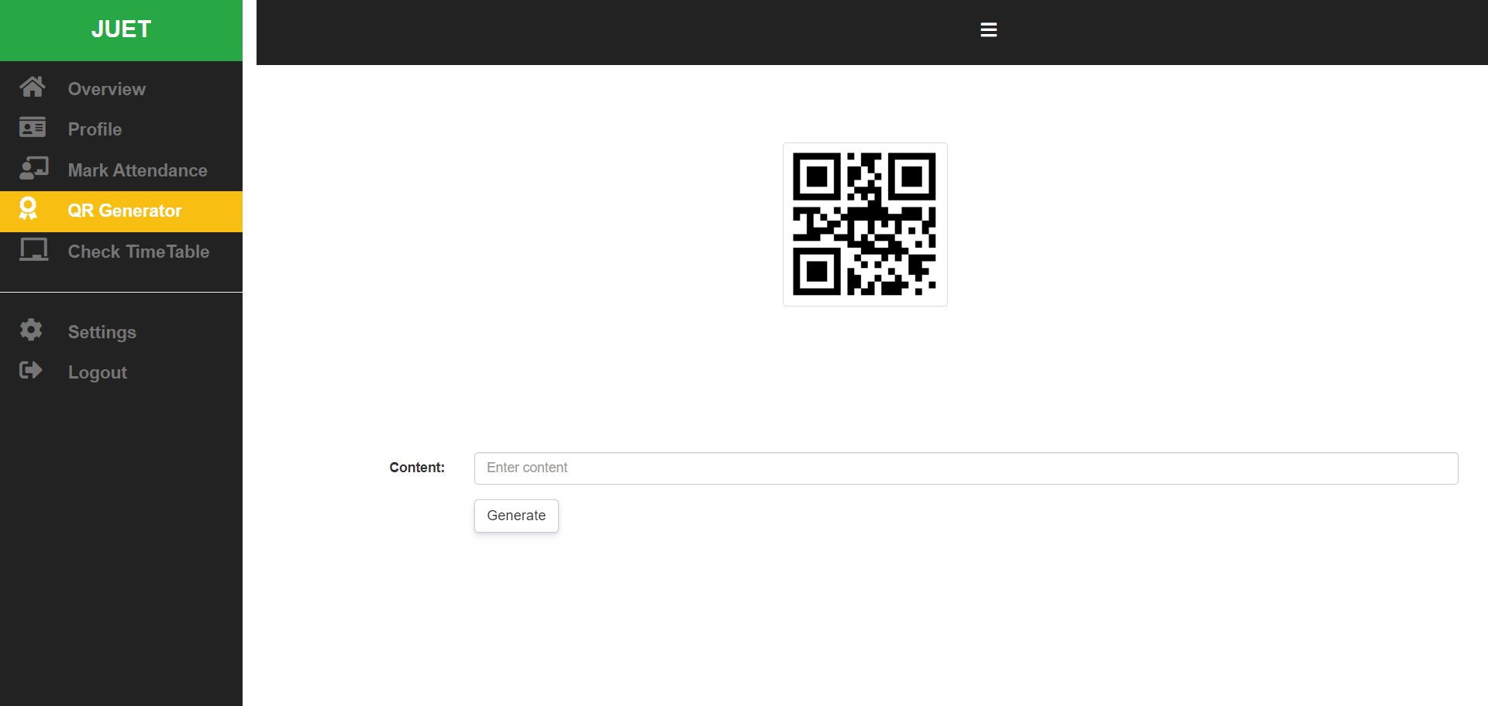
QR SCANNING FROM WEB
This QR Generator in web portal allows Teacher’s to generate QR for student’s to scan it and mark their present.

Slide 22
ADVANTAGES
1. Saves Time
2. Prevent proxy
3. No paper work
4. More efficient

Slide 23
SYSTEM REQUIREMENTS
HARDWARE SPECIFICATIONS
SOFTWARE SPECIFICATIONS
Mobile Phone:
2GB or more RAM
CPU having 1.5Ghz or more clock speed
PC:
4GB or more RAM
Core i3 or equivalent
Mobile Phone:
Android 6 or above
iOS 10 or above
PC:
Windows 7 or above
macOS High Sierra 10.13 or later

Slide 24
REFERENCES
1. 2nd International Conference on Advances in Science & Technology (ICAST-2019) K. J. Somaiya Institute of Engineering & Information Technology, University of Mumbai, Maharashtra, India.
2. Jamil, T. ; Dept. of Electr. & Comput. Eng., Sultan Qaboos Univ., Al Khod, Oman, Automatic attendance recording system using mobile telephone , Telecommunications Forum (TELFOR), 2011 19th 1297 – 1299
3. Qinghan Xiao ; Interdept. Biometrics Working Group, Gov. of Canada, ON ; Xue Dong Yang, A facial presence monitoring system for information security, Computational Intelligence in Biometrics: Theory, Algorithms, and Applications, 2009. CIB 2009. IEEE Workshop on, March 30 2009-April 2 2009 , 69 – 76.
4. Smartphone Users Around the World – Statistics and Facts, http://www.go-gulf.com/blog/smartphone/ visited on February 12, 2014.
5. Saraswat, Chitresh; Kumar, Amit, An Efficient Automatic Attendance System using Fingerprint Verification Technique. International Journal on Computer Science & Engineering . 2010, Vol. 2 Issue 2, p264-269.

Slide 25
THANKYOU

